Slide 1
Indian Sign Language To Text/Speech Translation
DEPARTMENT OF AIML (AIM) – IV-II Sem Project Review
Project batch No: A-12
PROJECT BY: PROJECT GUIDE:
TL: S.Jhansi Rani(21BQ1A6155) Mrs . M Lavanya
TM1: D.Yogitha( 21BQ1A6116)
TM2: A.NIkhil ( 21BQ1A6105)
TM3: B.Devesh(21BQ1A6110)

Slide 2
CONTENTS
Abstract
Existing System
Proposed System
Algorithm
Software Requirements
Hardware Requirements
Conclusion

Slide 3
Abstract
The Indian Sign Language to Text/Speech Translation system is designed to bridge the communication gap between the deaf and hard-of-hearing community and the hearing population.
This system utilizes state-of-the-art technologies, including Artificial Intelligence (AI), Computer Vision, and Natural Language Processing (NLP), to convert sign language gestures into real-time text and speech outputs.
Traditional communication methods rely on interpreters, but this system provides an automated, scalable, and cost-effective solution for real-time ISL translation.
The system incorporates deep learning models, such as Convolutional Neural Networks (CNN) and Long Short-Term Memory (LSTM), to recognize complex ISL gestures with high accuracy.
Computer Vision techniques, including OpenCV and MediaPipe, enhance real-time gesture recognition and ensure seamless user interaction.
The inclusion of a multilingual speech output feature enables the system to generate spoken language in various Indian languages, making it widely accessible across diverse linguistic communities.
The graphical user interface (GUI) is designed to be user-friendly, ensuring ease of use for individuals unfamiliar with technology.
This project holds significant potential for application in education, employment, and social interaction for individuals with hearing impairments, ultimately fostering a more inclusive society.
Future enhancements include expanding the dataset to cover additional gestures, improving recognition speed and accuracy, and developing a mobile application for broader accessibility.

Slide 4
Existing System
Most sign language recognition systems primarily focus on American Sign Language (ASL), leaving a gap in research and support for Indian Sign Language (ISL).
Limited publicly available datasets for ISL restrict the training and improvement of deep learning models, leading to lower accuracy and incomplete gesture recognition.
Many existing solutions struggle with real-time gesture recognition due to computational limitations, resulting in delays and making them impractical for real-world usage.
Traditional ISL-to-text conversion methods are not optimized for recognizing dynamic and complex gestures involving both hands and facial expressions.
There is a lack of integration with multiple Indian languages for speech output, making the technology less useful for diverse linguistic communities
Current systems often require expensive hardware setups, making accessibility a challenge, particularly in rural areas.
Existing approaches rely on fixed datasets and rule-based techniques, limiting their ability to generalize to new gestures and user variations.

Slide 5
Proposed System
Develop an AI-based system for ISL gesture recognition using deep learning.
Convert ISL gestures into real-time text and speech for effective communication.
Utilize deep learning models such as Convolutional Neural Networks (CNN) and Long Short-Term Memory (LSTM) for better accuracy.
Provide multilingual speech output in various Indian languages for wider accessibility.
Implement a user-friendly interface for ease of use,Optimize processing speed for real-time translation and Expand the dataset to cover a broad range of ISL gestures.

Slide 6
Algorithm
Step 1: Capture ISL gestures using a webcam in real-time.
Step 2: Pre-process images using OpenCV and MediaPipe to enhance gesture clarity.
Step 3: Apply CNN for feature extraction to identify hand movements and facial expressions.
Step 4: Use LSTM for sequence prediction to analyze continuous gestures.
Step 5: Convert recognized gestures into text by mapping features with a pre-trained dataset.
Step 6: Generate speech output in selected Indian languages using Natural Language Processing (NLP).
Step 7: Provide an interactive GUI for user-friendly communication.

Slide 7
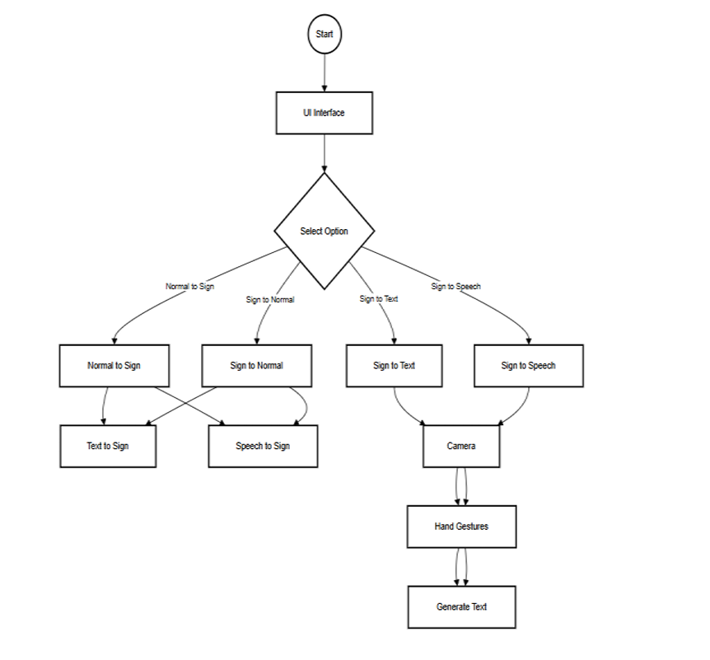

Slide 8
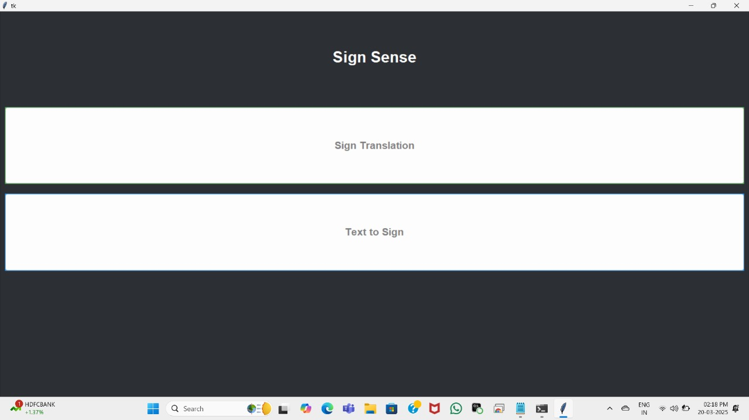
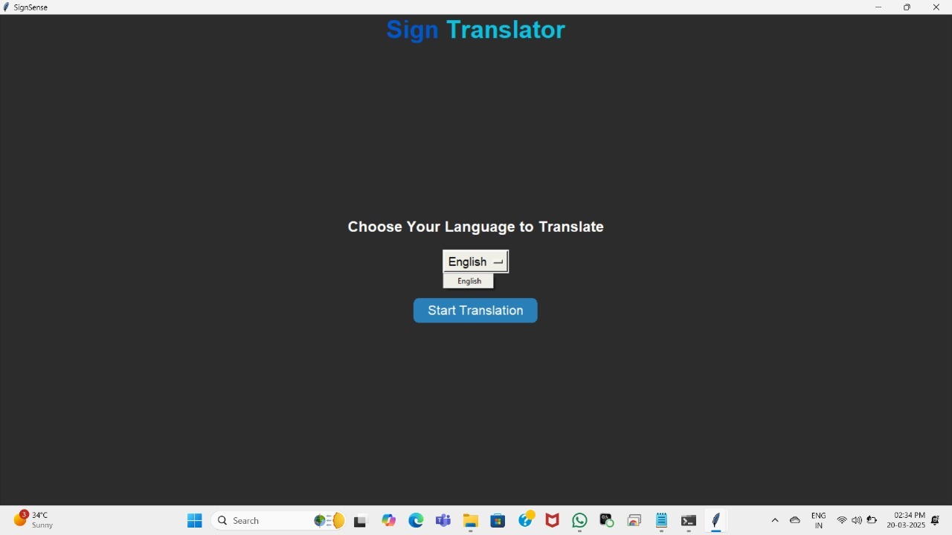
VISUALIZATION

Slide 9
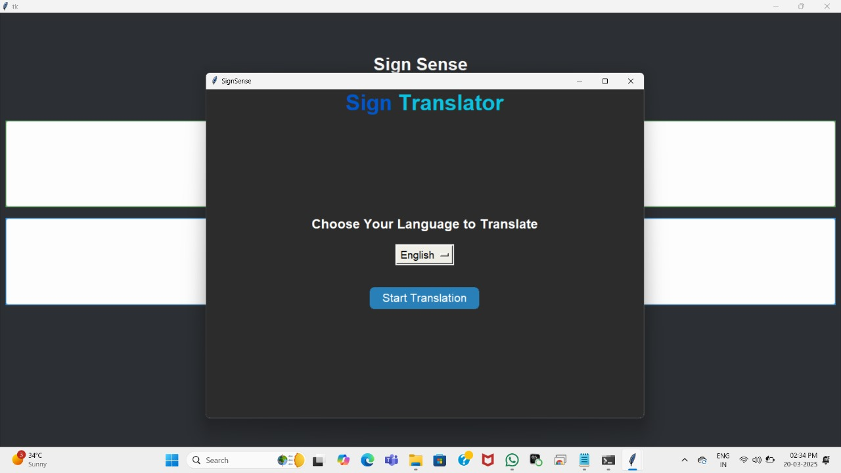
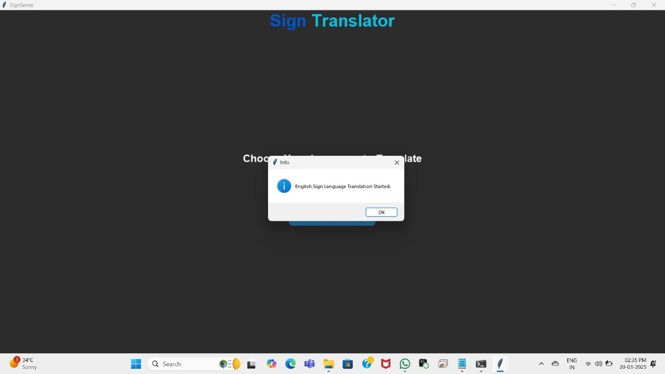

Slide 10
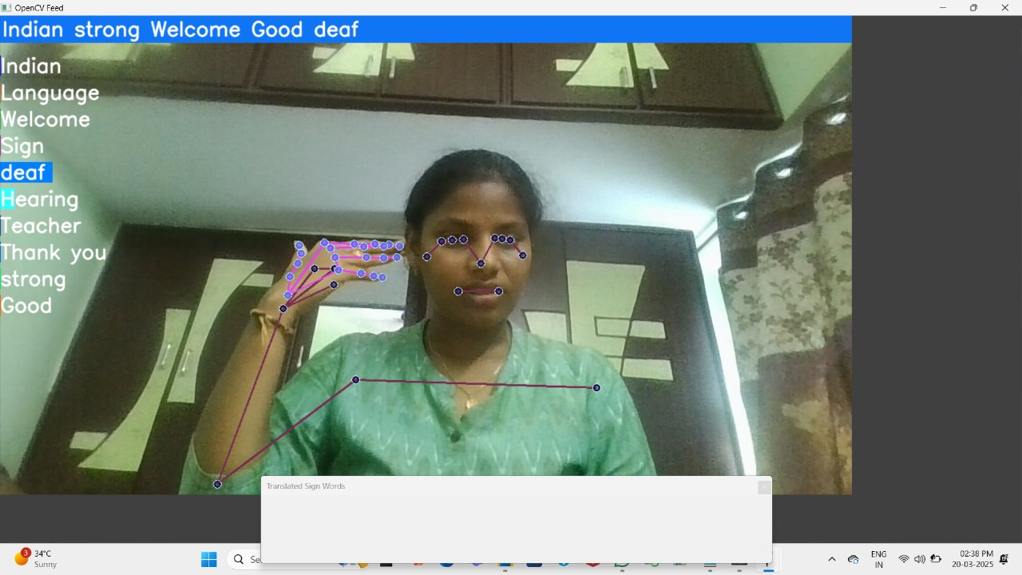

Slide 11
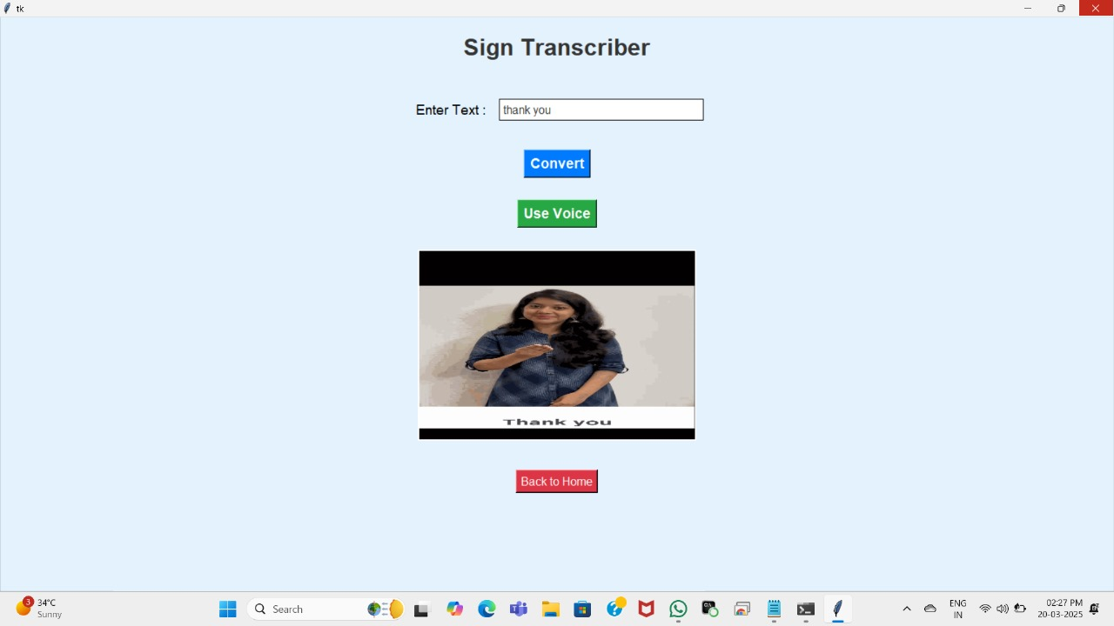

Slide 12
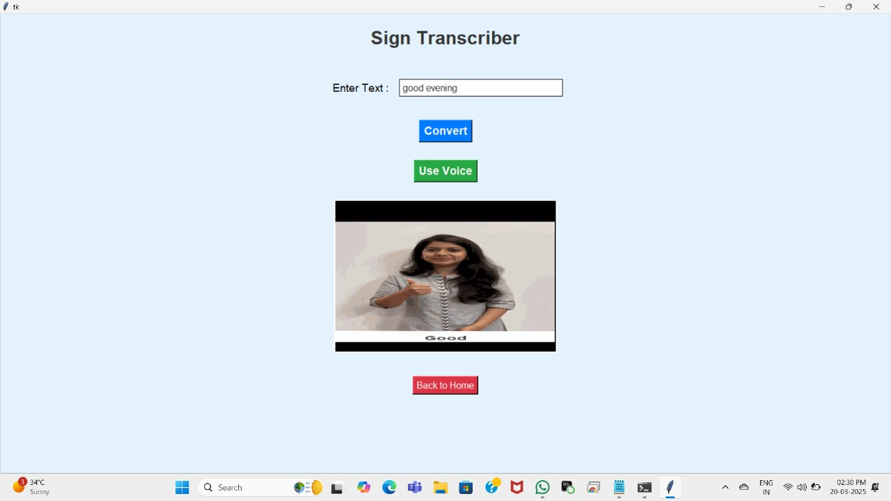

Slide 13
Software Requirements
Programming Language: Python (for AI model development and system integration).
Libraries & Frameworks: TensorFlow, OpenCV, MediaPipe, NLTK for machine learning and image processing.
Platform: Windows/Linux operating systems for broader compatibility.
Development Tools: Jupyter Notebook, PyCharm, Tkinter for GUI design and debugging.
Database Management: SQLite/MySQL for storing sign language datasets and user data.
API Integration: Google Text-to-Speech (TTS) API for speech synthesis.
Cloud Support: Integration with cloud-based storage for dataset expansion and remote access.

Slide 14
Hardware Requirements
Processor: Intel i5 or higher for efficient AI model execution.
RAM: Minimum 8GB to handle deep learning computations.
GPU: NVIDIA GTX 1050 or higher (recommended for faster neural network training and inference).
Camera: HD Webcam for real-time gesture recognition and image capturing
Microphone & Speaker: Required for text-to-speech conversion and user interaction.
External Storage: Minimum 256GB SSD for storing datasets and model weights.

Slide 15
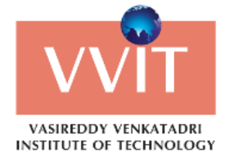
Conclusion
The Indian Sign Language (ISL) to text/speech translation system has been developed as an innovative solution to facilitate seamless communication between the deaf and hard-of-hearing community and the hearing world. The system leverages deep learning techniques, specifically Convolutional Neural Networks (CNN) and Long Short-Term Memory (LSTM) models, to accurately recognize and interpret ISL gestures. By employing advanced AI-driven recognition algorithms, it ensures high precision in real-time translations, enabling effective communication through text and multilingual speech outputs.
One of the key highlights of this system is its ability to provide instant sign language recognition with real-time responsiveness, making it highly practical for daily interactions. Additionally, the system is designed with a scalable and inclusive approach, supporting multiple Indian languages to enhance accessibility across diverse linguistic groups. Beyond its immediate capabilities, future developments aim to expand its usability by integrating it into mobile applications, improving gesture recognition accuracy, and broadening its scope to accommodate other sign languages. This AI-powered ISL translation system stands as a significant step towards fostering inclusivity, breaking communication barriers, and empowering individuals with hearing impairments to engage more freely in society.

Slide 16
THANK YOU

